Slide 1
Customer and Product Stack Management
Overview
This project is a console-based program that manages customer and product data using stack data structures. It is written in C/C++ and provides basic operations for adding and displaying data through a simple text-based menu interface.
Features
Two structures:
Customer: Stores customer-related data.
Product: Stores product-related data.
Functions to:
Add new customers or products to their respective stacks.
Display and print all customer and product data from top to bottom.
Interactive menu that allows the user to choose operations.
Proper validation for menu input.
Graceful exit from the program.
قوت الكليب – 223034673
وجدان العطية – 223005583
رغد الغامدي – 223039847
رهف الكشي – 223011284
README

Slide 2
Menu System
When the program runs, a menu is displayed with the following options:
Add new customer
Add new product
Display all customers
Display all products
Exit the program
If the user enters an invalid choice, the program will respond with:
When option 0 is selected, the program will exit with the message:
Compilation
To compile the project using g++:
README
Invalid choice.
Exiting...
g++ -o stackManager main.cpp./stackManager

Slide 3
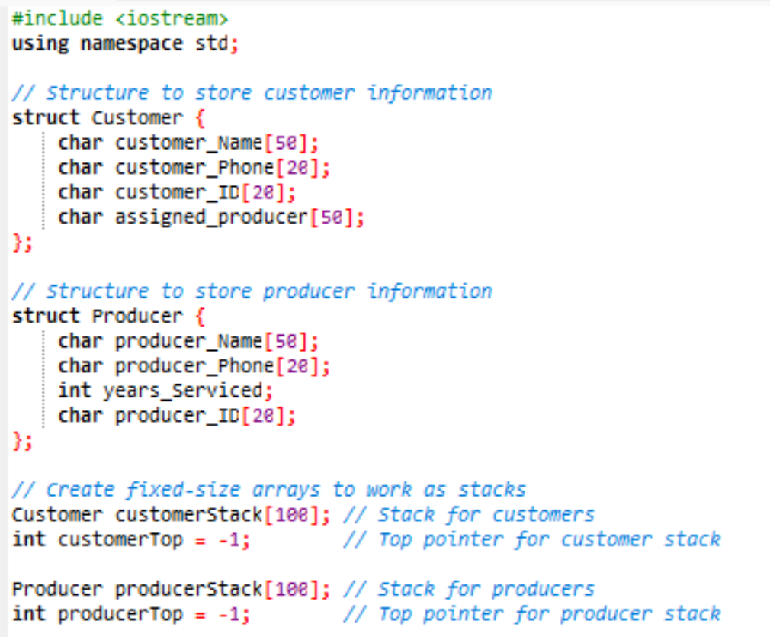
Create Two structures to store customer and product details

Slide 4
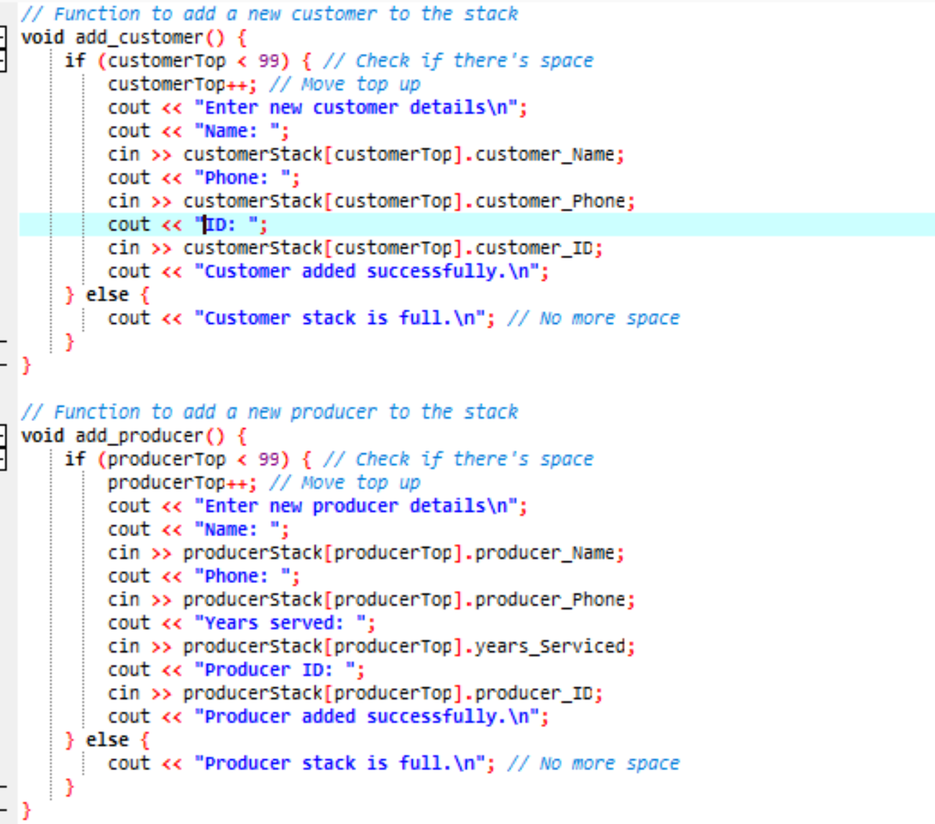
Create function to Add a new Costumer or Producer to the stack

Slide 5
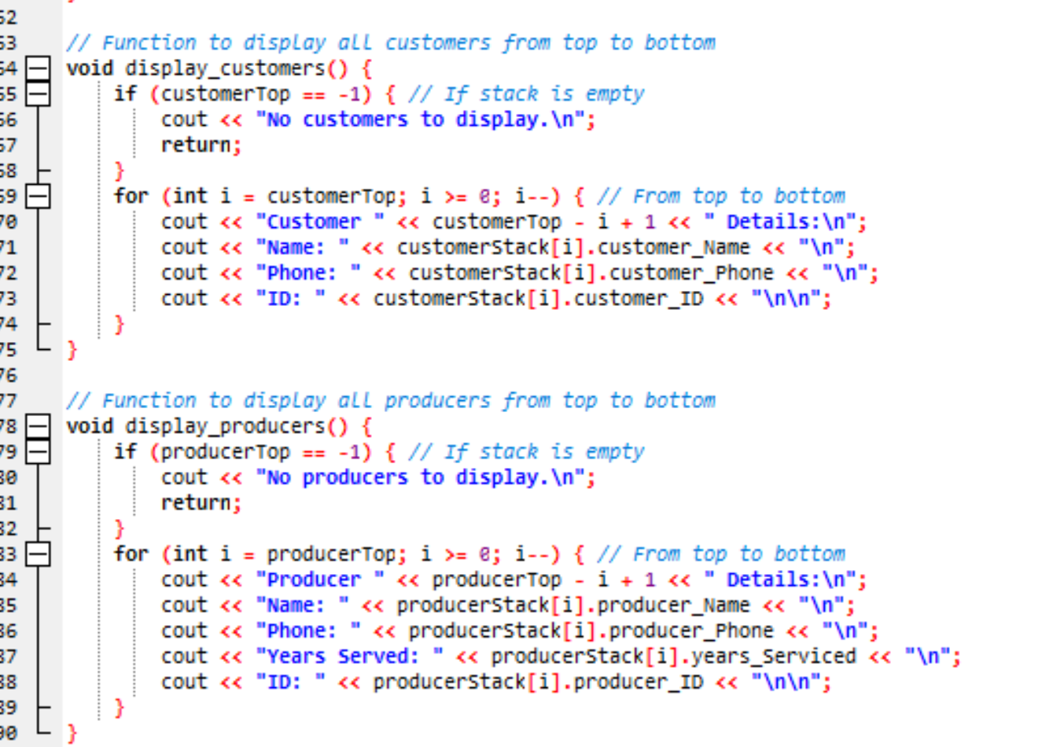
Create functions to display and print all customer and product details from top to bottom

Slide 6
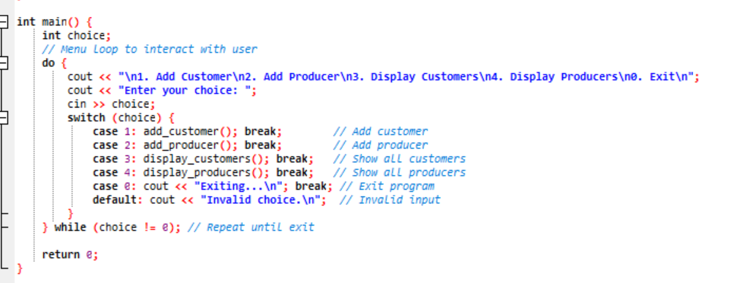
The main function that has a menu loop for interaction with the user

Slide 7
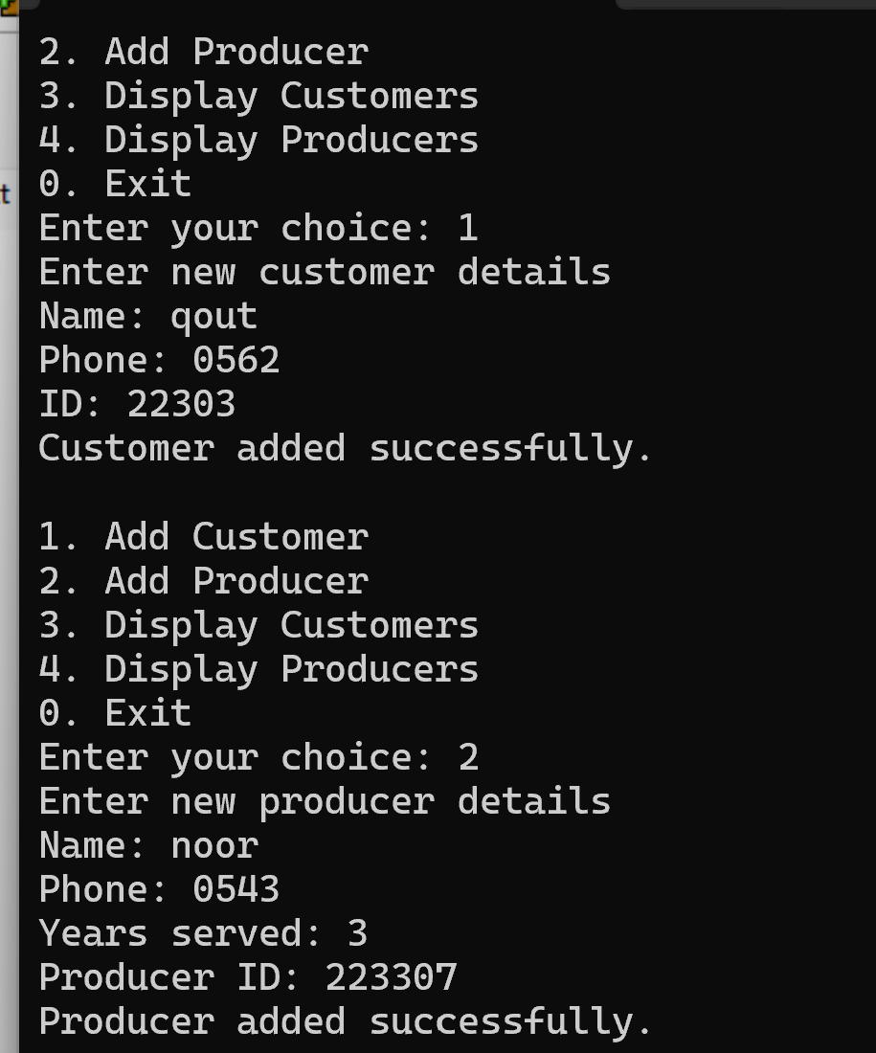
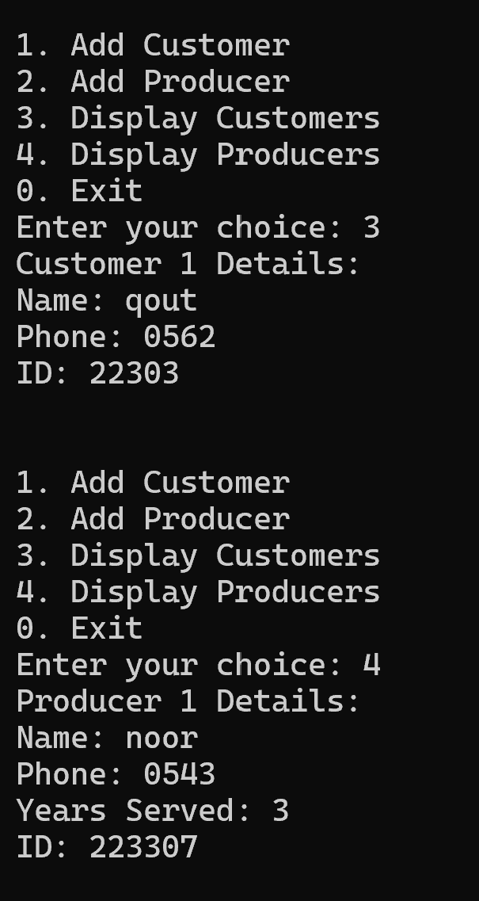
First , the output will show to the user list “First, a menu will appear allowing the user to select an action, such as adding or displaying data.”

Slide 8
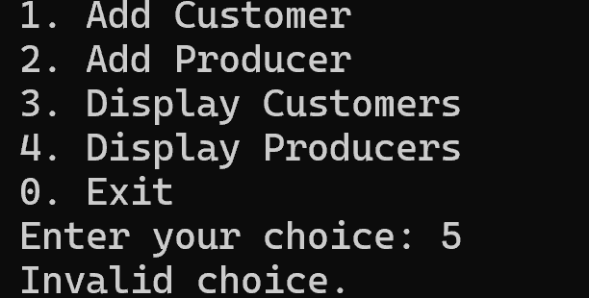
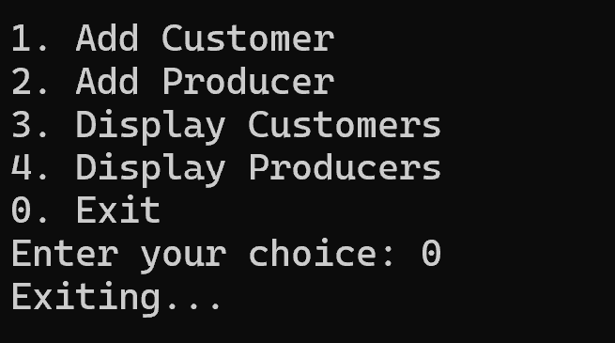
If the user enters an invalid option that is not listed in the menu, the program displays the message “Invalid choice.”
When the user selects option 0, the program exits and shows the message “Exiting…”

